Slide 1
CHAROTAR UNIVERSITY OF SCIENCE AND TECHNOLOGY FACULTY OF APPLIED SCIENCES DEPARTMENT OF MATHEMATICAL SCIENCES SEMESTER 3 BTech CE, IT, CSE
DISCRETE MATHEMATICS AND ALGEBRA
MA253
UNIT 1
PREDICATE CALCULUS

Slide 2
OUTLINE OF UNIT 1 – PREDICATE CALCULUS
PROPOSITION, TYPES OF PROPOSITION, TAUTOLOGY, CONTRADICTIONS.
CONNECTIVES, TYPES OF CONNECTIVES AND ITS PROPERTIES.
LOGICAL EQUIVQLENCE, VERIFICATION USING TRUTH TABLE.
CONVERSE, INVERSE AND CONTRAPOSITIVE.
MINIMAL FUNCTIONALLY COMPLETE SET OF CONNECTIVES.
NORMAL FORMS: DNF, CNF, PDNF, PCNF.
LOGIC IN PROOF.

Slide 3
SENTENCE: A collection of words making a complete grammatical structure with meaning and sense is known as sentence.
PROPOSITION: A declarative sentence which can be either true or false is known a Proposition. It is also known as statement.
Consider, for example, the following sentences in English
New Delhi is the capital of India.
The square of 4 is 16.
Bring me coffee.
This statement is false.

Slide 4
The statement 1-2 is proposition as the sentence 1 and 2 are true. To sentence 3 we cannot decide whether it is true or false as it is not a declarative sentence. Sentence 4 has both true as well as false value so 4 is not a proposition.
TRUTH VALUE: The truth or falsity of a statement is known as its truth value. Propositions are denoted by p, q, r... or P, Q, R... and also known as propositional variables.
ATOMIC STATEMENT: A proposition consisting of only a single propositional variable or a single propositional constant is known as atomic statement. It is also known as primary or primitive proposition.

Slide 5
COMPOUND STATEMENT: A proposition, which is combination of two or more propositional variables, is known as compound statement. It is also known as molecular or composite statement.
TRUTH TABLE: A truth table is a table that shows the truth value of a compound proposition for all possible value.
CONNECTIVES: The words or phrases which are used to form a proposition are known as connectives. There are five basic connectives: Negation, Conjunction, Disjunction, Conditional and Bi- conditional.

Slide 6
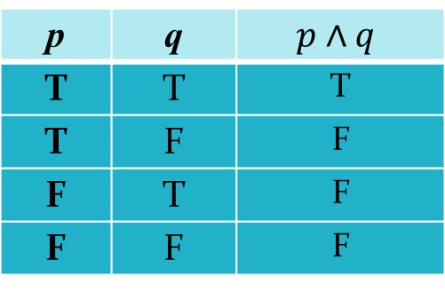
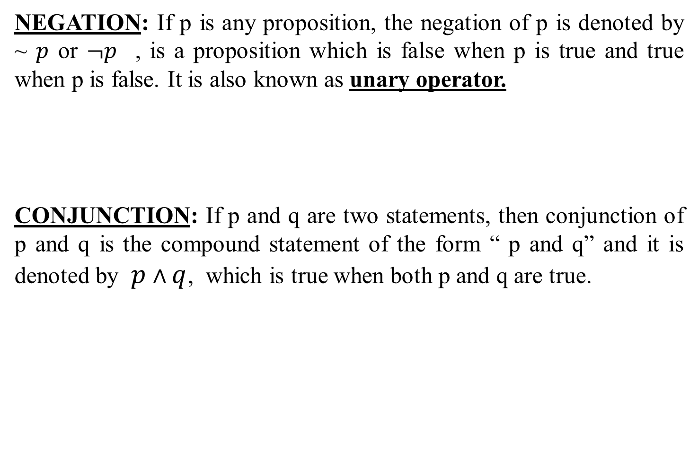
NEGATION: If p is any proposition, the negation of p is denoted by ~ $p$ or $¬p$ , is a proposition which is false when p is true and true when p is false. It is also known as unary operator.
CONJUNCTION: If p and q are two statements, then conjunction of p and q is the compound statement of the form “ p and q” and it is denoted by $p∧q$, which is true when both p and q are true.
p | ~p
T | F
F | T
p | q
T | T | T
T | F | F
F | T | F
F | F | F

Slide 7
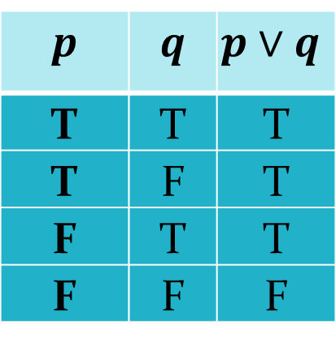


DISJUNCTION: If p and q are two statements, then disjunction of p and q is the compound statement of the form “ p or q” and it is denoted by which is false when both p and q are false.
CONDITIONAL: If p and q are two statement, then conditional statement of p and q is the compound statement of the form “ if p then q” and it is denoted by , which is false when p is true and q is false.
$p∨$q
p | q
T | T | T
T | F | T
F | T | T
F | F | F
$$p→q$$

Slide 8

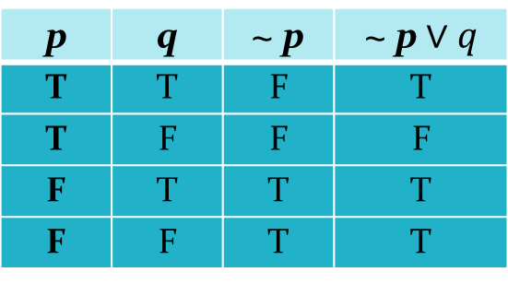
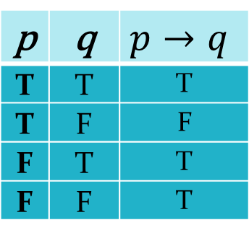
p | q
T | T | T
T | F | F
F | T | T
F | F | T
Remark:
In $p→q$, the proposition p is called antecedent or hypothesis and proposition q is called consequent or conclusion.
The connective if........then can be also read as follows:
p implies q.
p is sufficient for q.
p only if q.
q is necessary for p.
q if p.
q follows from p.
q is consequence of p.
$p→q≡∼p∨q$
p | q | ~ p | ~ p$∨q$
T | T | F | T
T | F | F | F
F | T | T | T
F | F | T | T

Slide 9
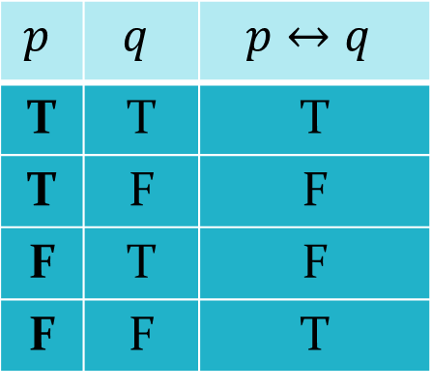
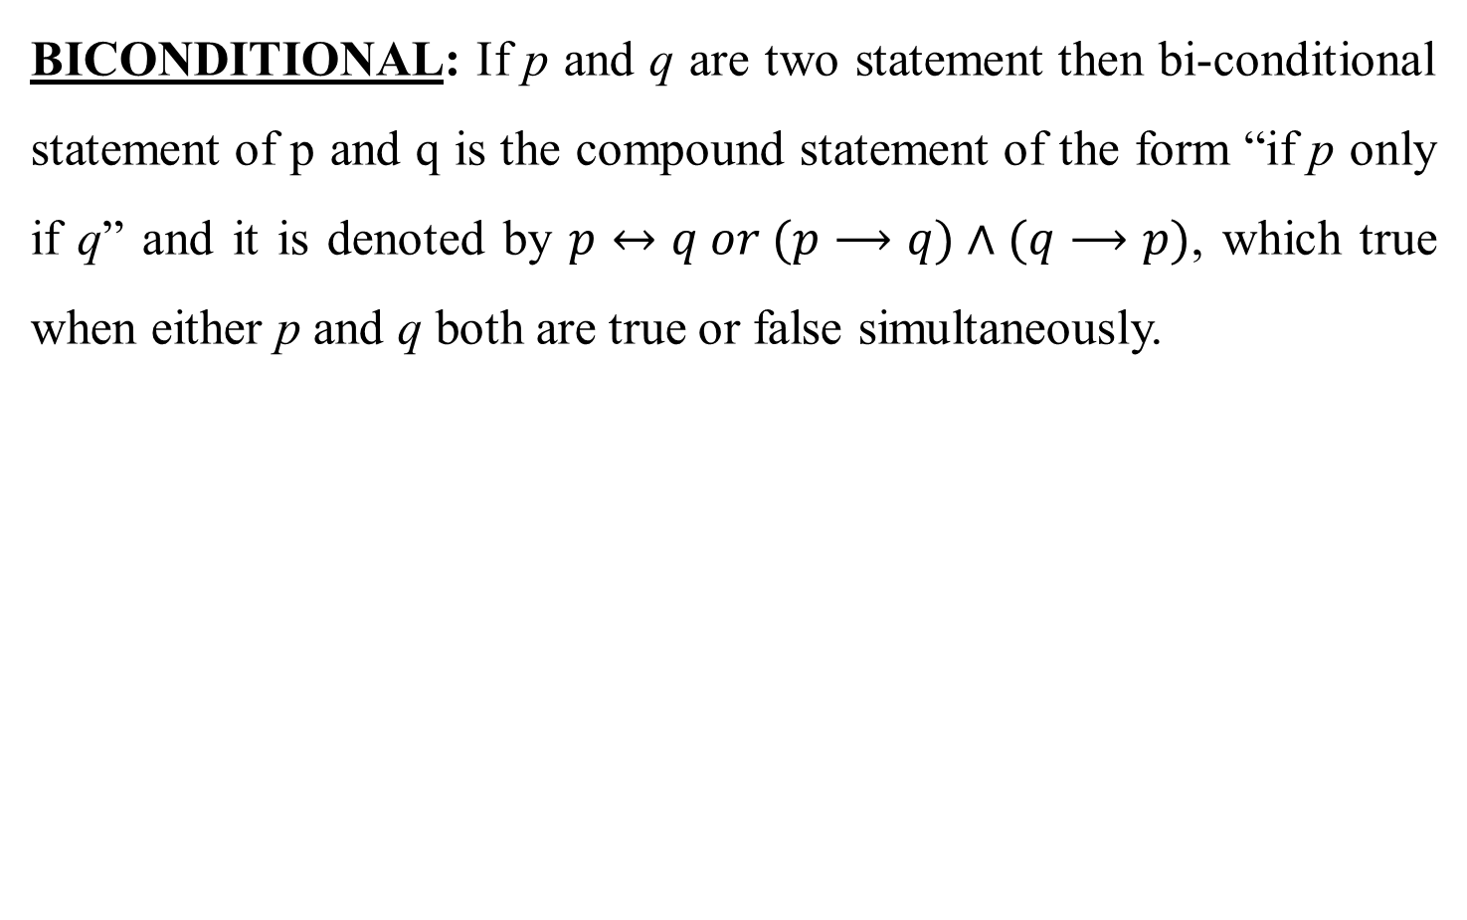
BICONDITIONAL: If p and q are two statement then bi-conditional statement of p and q is the compound statement of the form “if p only if q” and it is denoted by $p↔q or (p⟶q)∧(q⟶p)$, which true when either p and q both are true or false simultaneously.
T | T | T
T | F | F
F | T | F
F | F | T

Slide 10
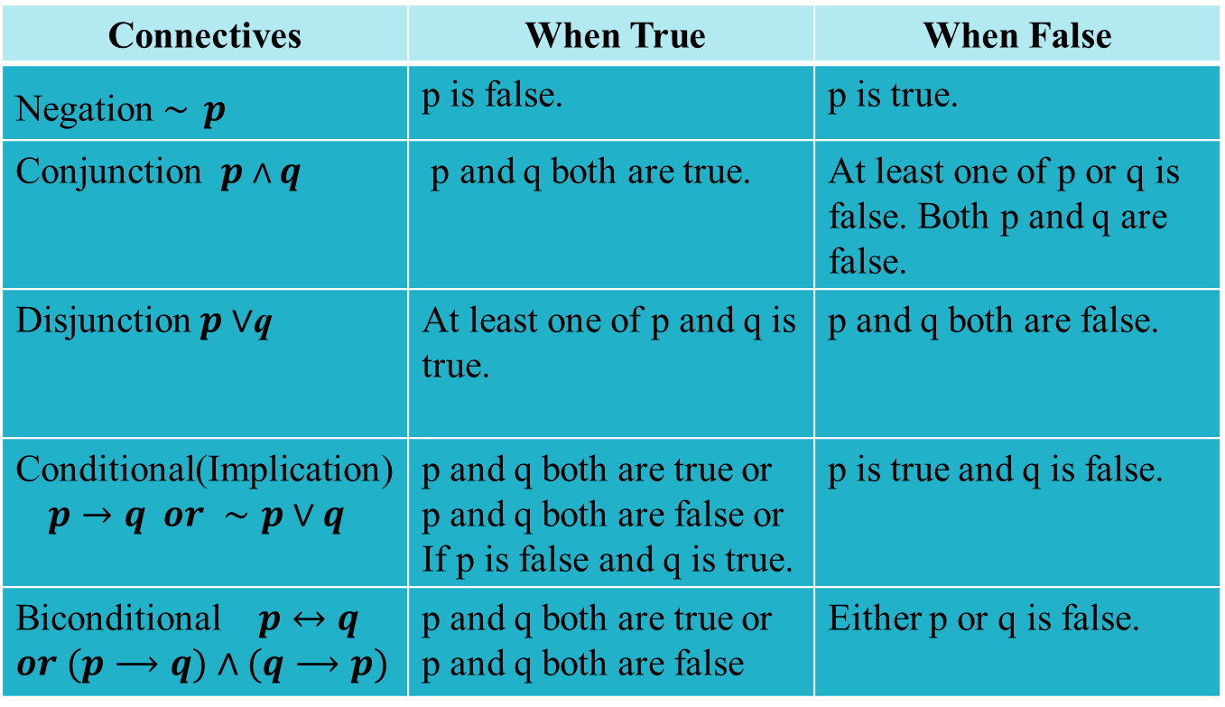
Connectives and truth table
Connectives | When True | When False
Negation $∼$ $p$ | p is false. | p is true.
Conjunction $p∧q$ | p and q both are true. | At least one of p or q is false. Both p and q are false.
Disjunction $p∨$q | At least one of p and q is true. | p and q both are false.
Conditional(Implication) $$p→q or ∼p∨q$$ | p and q both are true or p and q both are false or If p is false and q is true. | p is true and q is false.
Biconditional $p↔q$ $or (p⟶q)∧(q⟶p)$ | p and q both are true or p and q both are false | Either p or q is false.

Slide 11
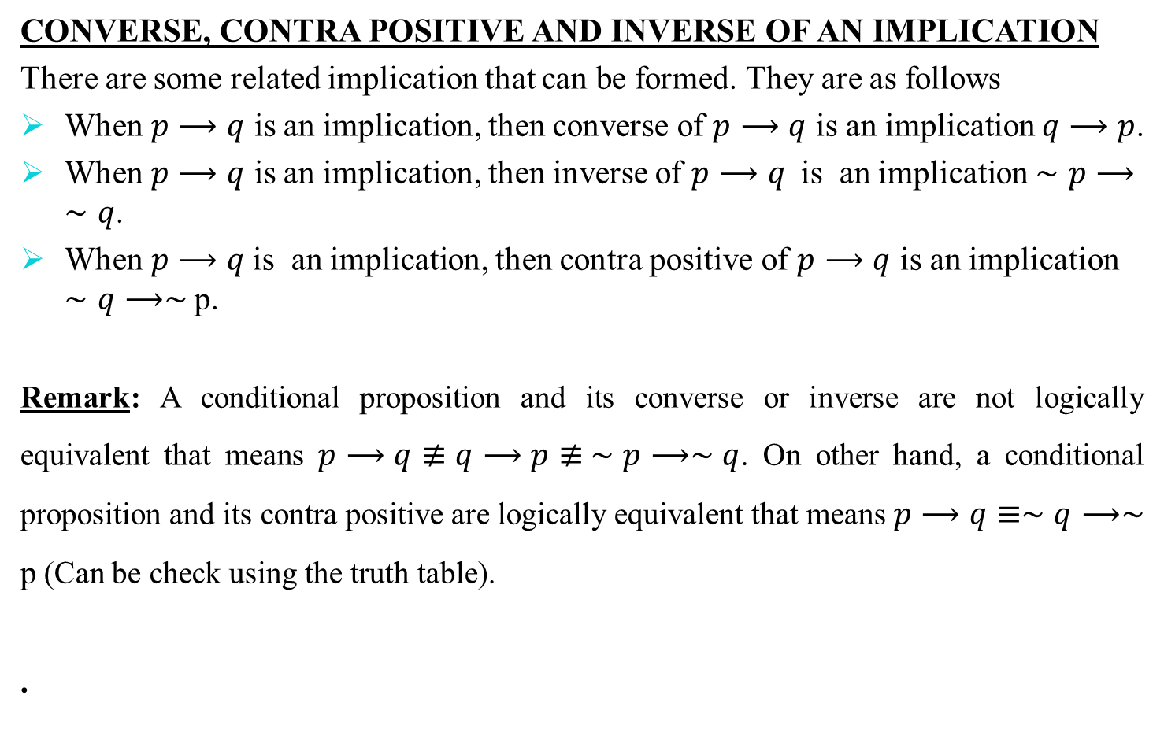
CONVERSE, CONTRA POSITIVE AND INVERSE OF AN IMPLICATION
There are some related implication that can be formed. They are as follows
When $p⟶q$ is an implication, then converse of $p⟶q$ is an implication $q⟶p$.
When $p⟶q$ is an implication, then inverse of $p⟶q$ is an implication $∼p⟶∼q$.
When $p⟶q$is an implication, then contra positive of $p⟶q$ is an implication $∼q⟶∼$ p.
Remark: A conditional proposition and its converse or inverse are not logically equivalent that means$p⟶q≢q⟶p≢ ∼p⟶∼q$. On other hand, a conditional proposition and its contra positive are logically equivalent that means $p⟶q≡∼q⟶∼$ p (Can be check using the truth table).
.

Slide 12
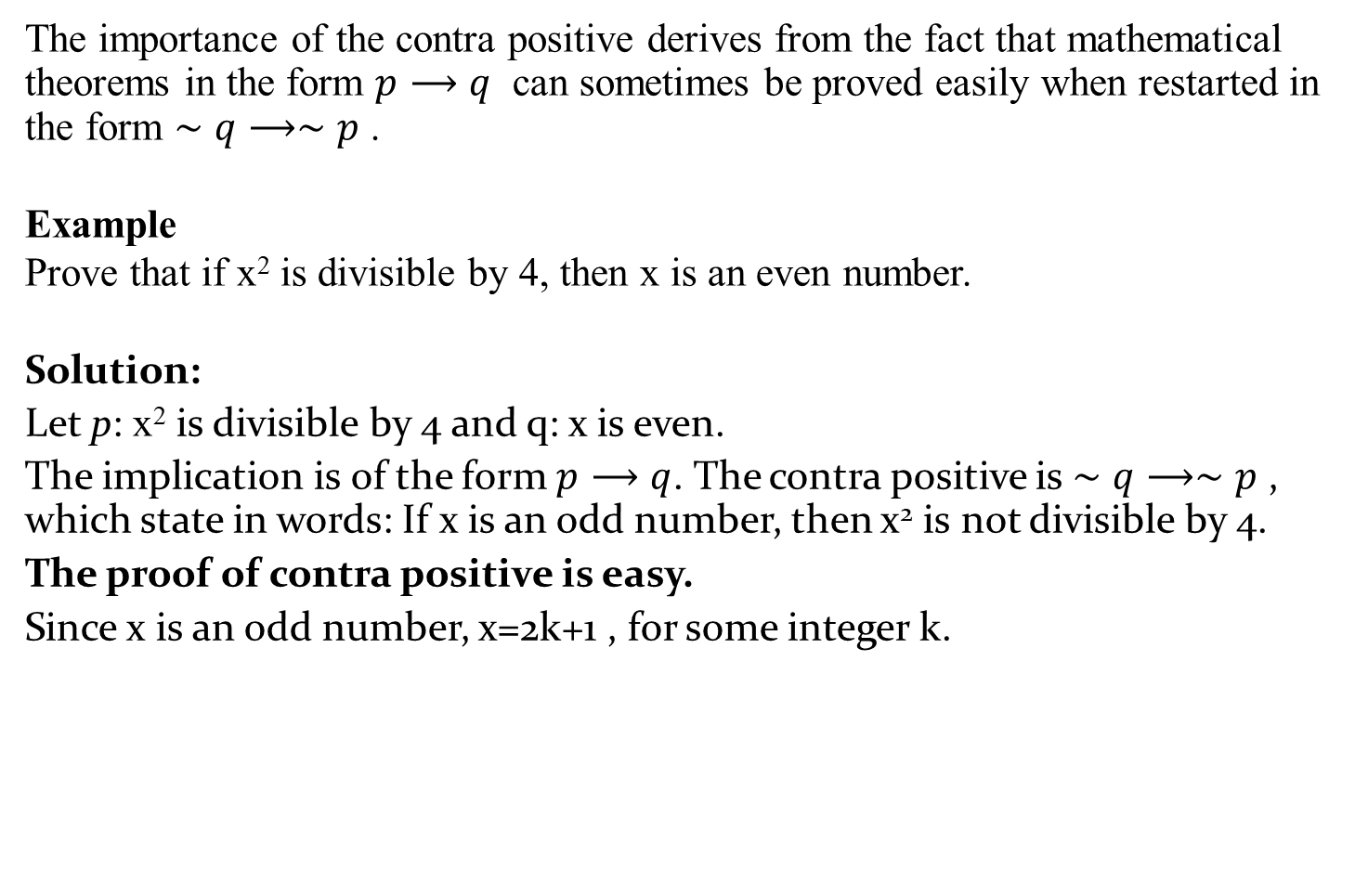
The importance of the contra positive derives from the fact that mathematical theorems in the form $p⟶q$ can sometimes be proved easily when restarted in the form $∼q⟶∼p$ .
Example
Prove that if x² is divisible by 4, then x is an even number.
Solution:
Let p: x² is divisible by 4 and q: x is even.
The implication is of the form $p⟶q$. The contra positive is $∼q⟶∼p$ , which state in words: If x is an odd number, then x² is not divisible by 4.
The proof of contra positive is easy.
Since x is an odd number, x=2k+1 , for some integer k.

Slide 13
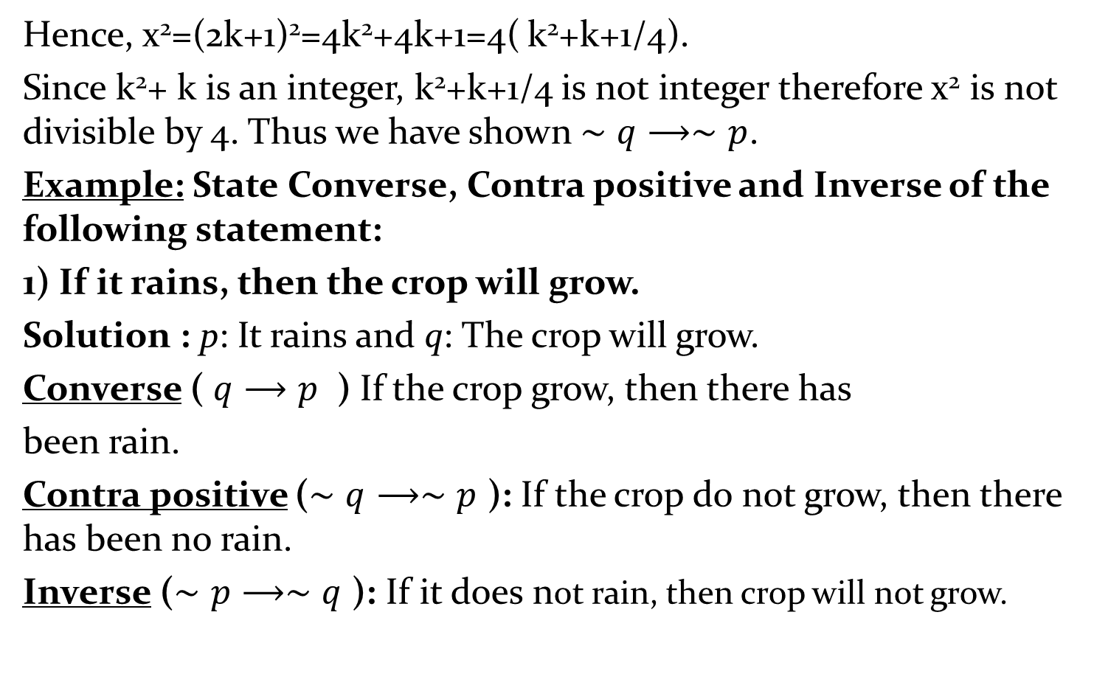
Hence, x²=(2k+1)²=4k²+4k+1=4( k²+k+1/4).
Since k²+ k is an integer, k²+k+1/4 is not integer therefore x² is not divisible by 4. Thus we have shown $∼q⟶∼p$.
Example: State Converse, Contra positive and Inverse of the following statement:
1) If it rains, then the crop will grow.
Solution : p: It rains and q: The crop will grow.
Converse ( $q⟶p$ ) If the crop grow, then there has
been rain.
Contra positive ($∼q⟶∼p$ ): If the crop do not grow, then there has been no rain.
Inverse ($∼p⟶∼q$ ): If it does not rain, then crop will not grow.

Slide 14
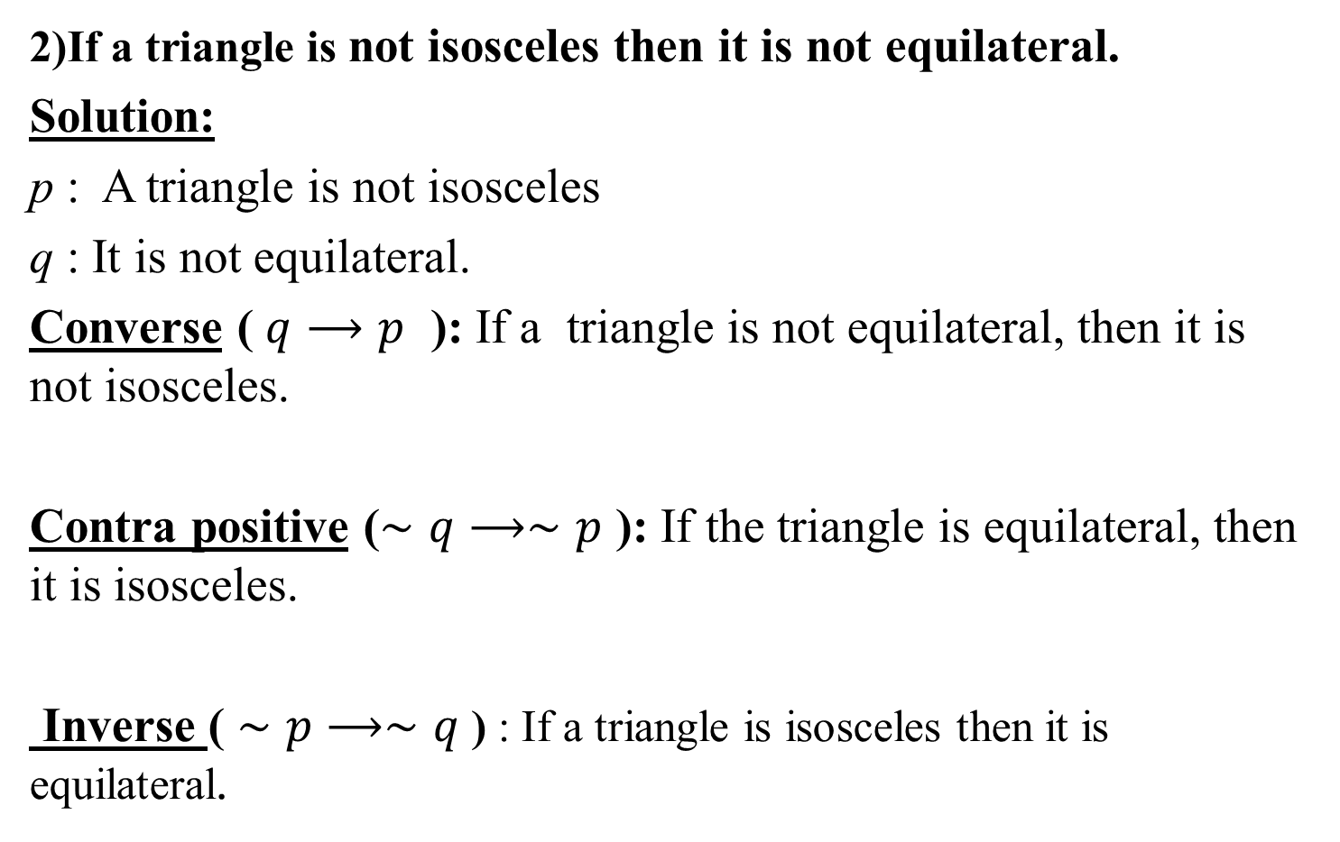
2)If a triangle is not isosceles then it is not equilateral.
Solution:
p : A triangle is not isosceles
q : It is not equilateral.
Converse ( $q⟶p$ ): If a triangle is not equilateral, then it is not isosceles.
Contra positive ($∼q⟶∼p$ ): If the triangle is equilateral, then it is isosceles.
Inverse ( $∼p⟶∼q$ ) : If a triangle is isosceles then it is equilateral.

Slide 15
PRATICE EXAMPLE
Example: State Converse, Contra positive and Inverse of the following statement:
1) If a triangle is isosceles, then two of its sides are equal.
2) If there is no unemployment in India , then the Indian’s won’t go to the USA for employment.

Slide 16
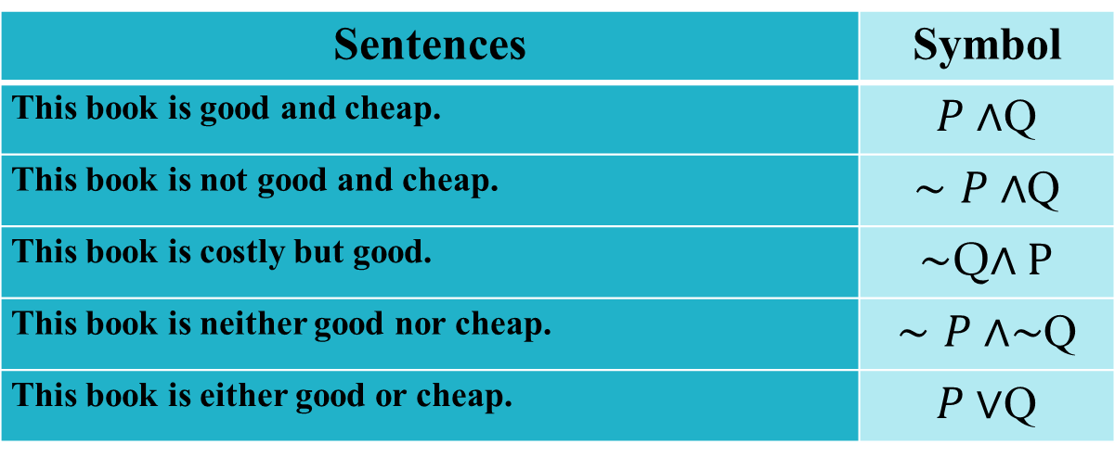
Example: If P represents “This book is good“ and Q represent “This book is cheap”, then write the following sentences in symbolic form.
Solution: Here
Sentences | Symbol
This book is good and cheap.
This book is not good and it is cheap.
This book is costly but good.
This book is neither good nor cheap.
This book is either good or cheap.

Slide 17
Example: If P: It is raining, Q: I have the time, R: I will go to a movie. Write the sentences in English corresponding to the following propositional form ,
and .
 | I will go to a movie if and only if it is not raining and I have the time
 | I will go to movie if and only if I have the time.
 | It is not the case that I have the time or I will go to a movie
 | I will go to a movie only if it is not raining and I have the time

Slide 18
Example: Construct a truth table for each compound proposition.
1)
Solution :
p | q | ~ q
T | T | F | T | T
T | F | T | T | T
F | T | F | T | F
F | F | T | T | F

Slide 19
2)
Solution :
P | Q
T | T | T | T | T | T | T
T | F | T | F | F | T | F
F | T | T | T | T | F | F
F | F | F | T | F | T | F

Slide 20
PRATICE EXAMPLE
Obtain the truth table for the following:

Slide 21
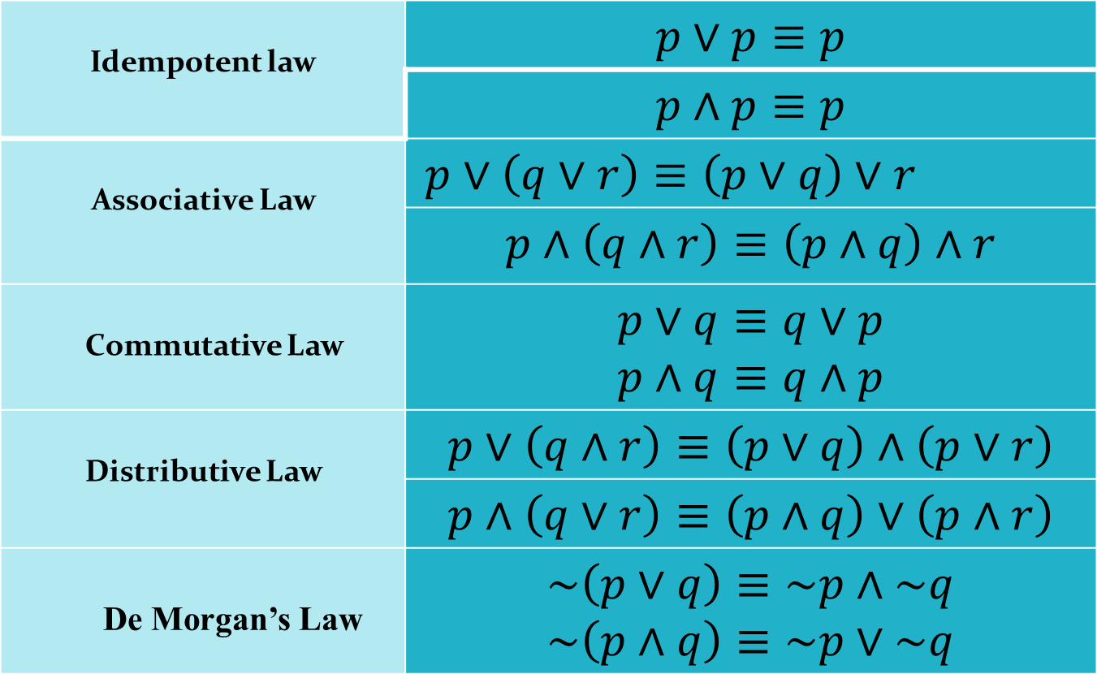
ALGEBRA OF PROPOSITION
Idempotent law
Associative Law
Commutative Law
Distributive Law
De Morgan’s Law

Slide 22

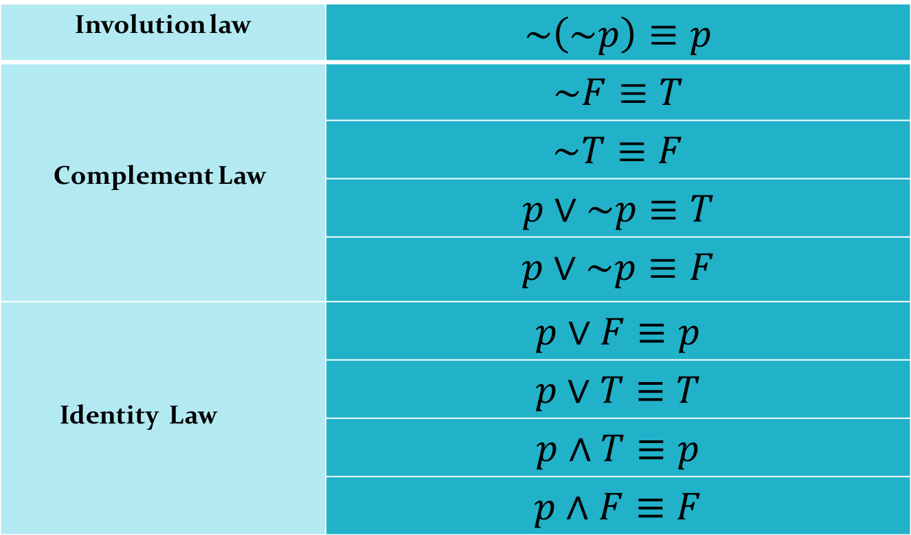
ALGEBRA OF PROPOSITION ( Continued)
Involution law
Complement Law
Identity Law

Slide 23
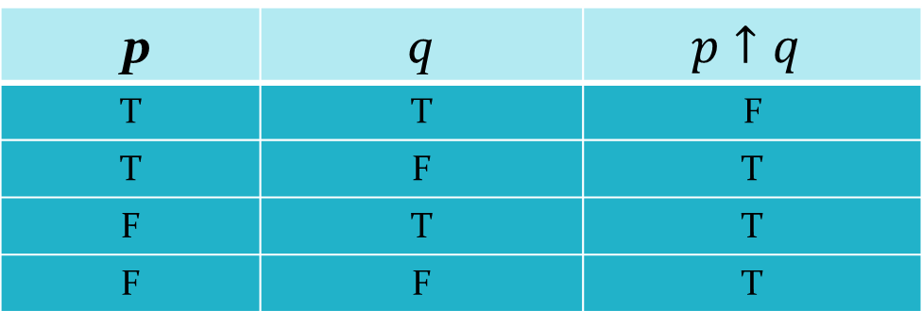
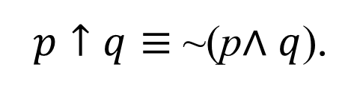
.
.
SOME DERIVED CONNECTIVES
NAND: NAND is the negation of conjunction of two statements. Assume p and q are any two statement then NAND of p and q is a proposition which is false when both p and q are true otherwise true. It is denoted by
$p↑q≡$ ~(p$∧q$).
p | q
T | T | F
T | F | T
F | T | T
F | F | T

Slide 24

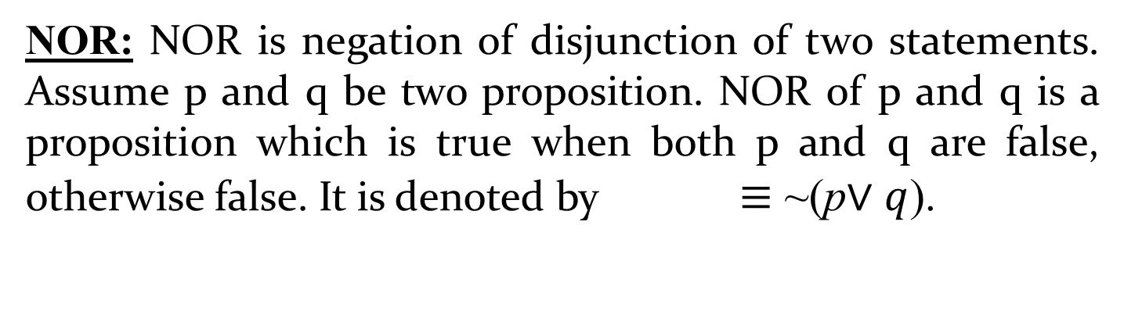
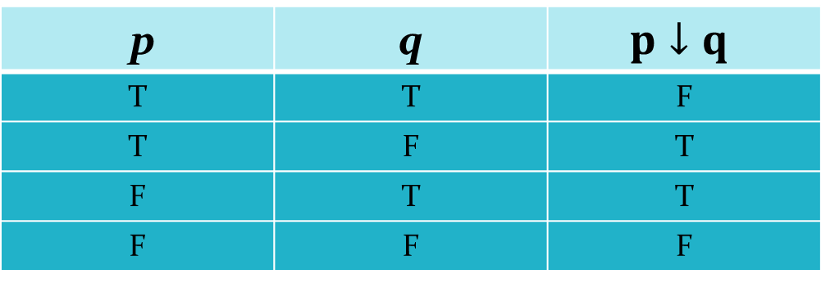
SOME DERIVED CONNECTIVES ( Continued)
NOR: NOR is negation of disjunction of two statements. Assume p and q be two proposition. NOR of p and q is a proposition which is true when both p and q are false, otherwise false. It is denoted by $≡$ ~(p$∨q$).
$$p↓q$$
p | q
T | T | F
T | F | F
F | T | F
F | F | T

Slide 25
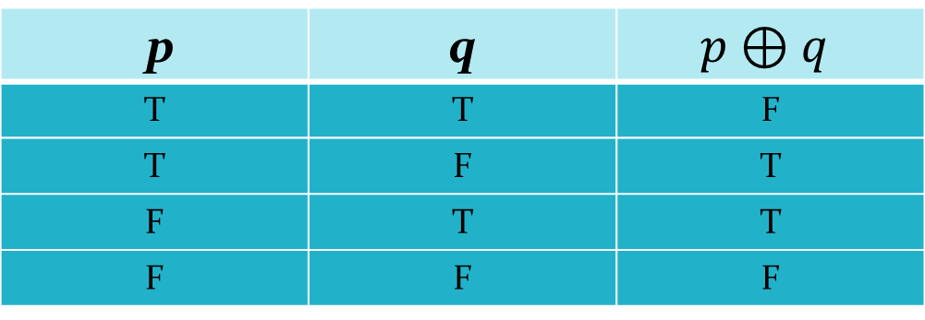

SOME DERIVED CONNECTIVES (Continued)
XOR (Exclusive or ): It is a proposition that is true when exactly one of p and q is true but not both and is false otherwise. It is denoted by$p⊕q≡ \text{\sim }\text{(}\text{p}↔q\text{)}$.
p | q
T | T | F
T | F | T
F | T | T
F | F | F

Slide 26
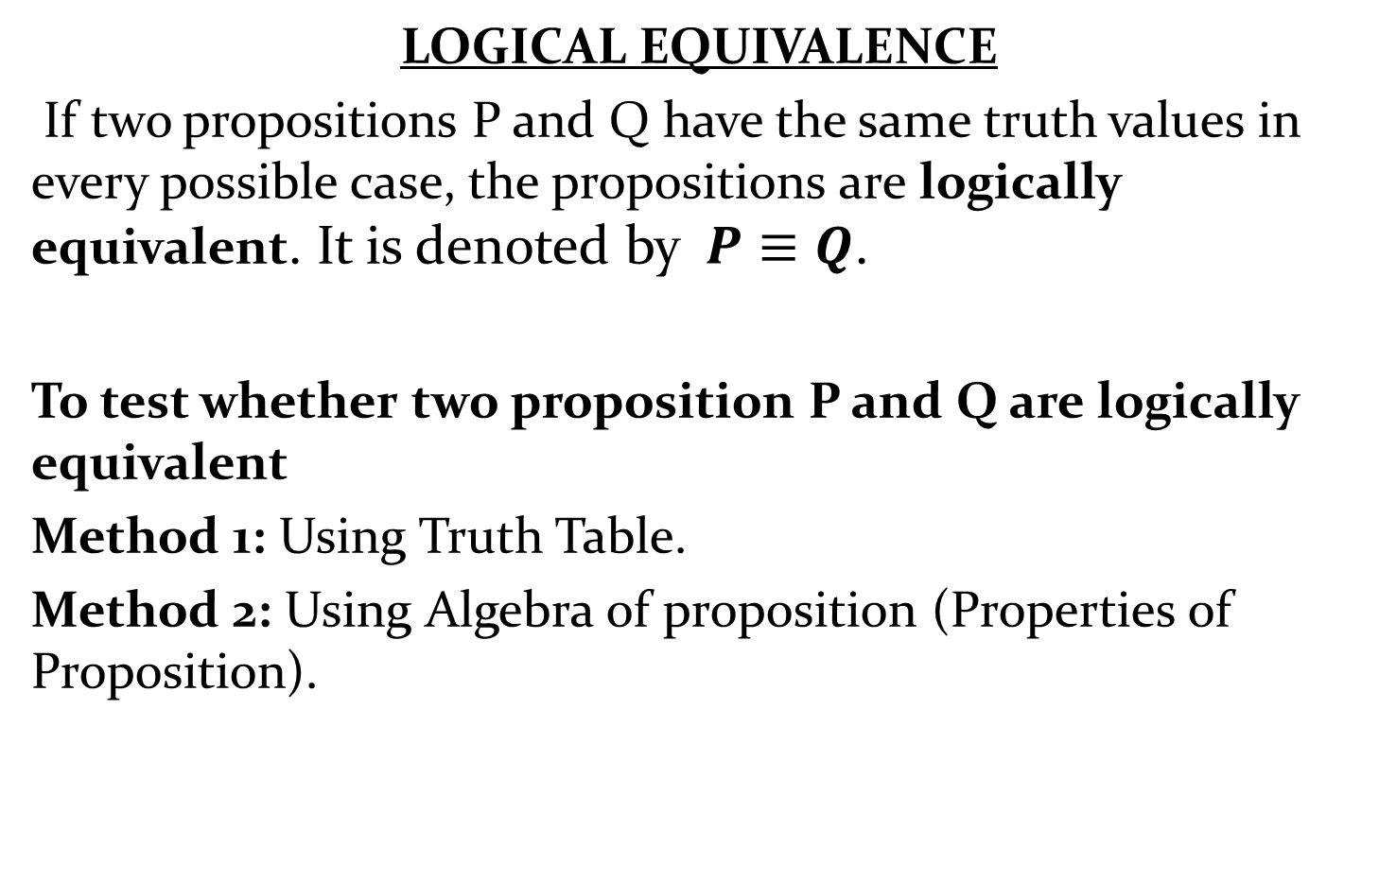
.
LOGICAL EQUIVALENCE
If two propositions P and Q have the same truth values in every possible case, the propositions are logically equivalent. It is denoted by$P≡Q$.
To test whether two proposition P and Q are logically equivalent
Method 1: Using Truth Table.
Method 2: Using Algebra of proposition (Properties of Proposition).

Slide 27
Method 1: Using Truth Table
Step 1: Construct the truth Table for compound statement P
and Q.
Step 2: Check each combination of truth values of the
propositional variables to see whether the value of P
is same as the truth value of Q. If in each row the
truth value of P is the same as the truth value of Q,
then P and Q are logically equivalent.

Slide 28


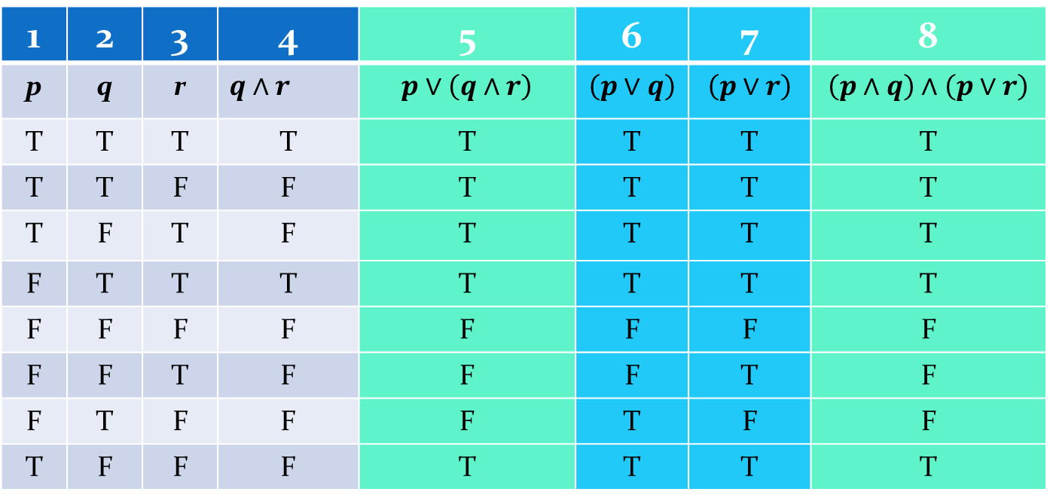
Example: Use truth tables to prove
Since the entries in 5 and 8 columns is same, therefore
$$p∨\left(q∧r\right)≡\left(p∧q\right)∧\left(p∨r\right)$$
$$p∨\left(q∧r\right)≡\left(p∨q\right)∧\left(p∨r\right)$$
1 | 2 | 3 | 4 | 5 | 6 | 7 | 8
p | q | r
T | T | T | T | T | T | T | T
T | T | F | F | T | T | T | T
T | F | T | F | T | T | T | T
F | T | T | T | T | T | T | T
F | F | F | F | F | F | F | F
F | F | T | F | F | F | T | F
F | T | F | F | F | T | F | F
T | F | F | F | T | T | T | T

Slide 29


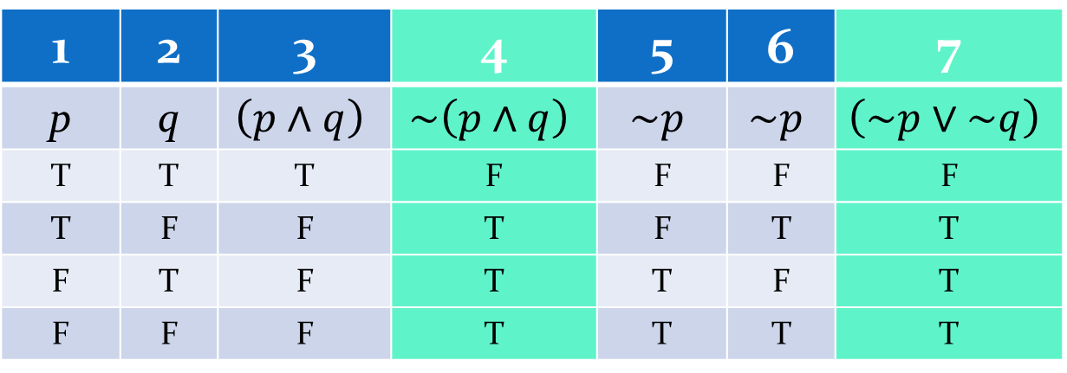
Example: Use truth tables to prove
Since the entries in 4 and 7 columns is same, therefore
$\sim \left(p∧q\right)≡\left(\sim p∨\sim q\right)$.
$$\sim \left(p∧q\right)≡\left(\sim p∨\sim q\right)$$
1 | 2 | 3 | 4 | 5 | 6 | 7
p | q
T | T | T | F | F | F | F
T | F | F | T | F | T | T
F | T | F | T | T | F | T
F | F | F | T | T | T | T

Slide 30
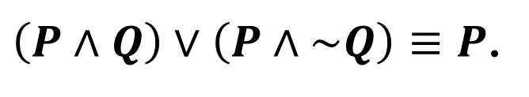

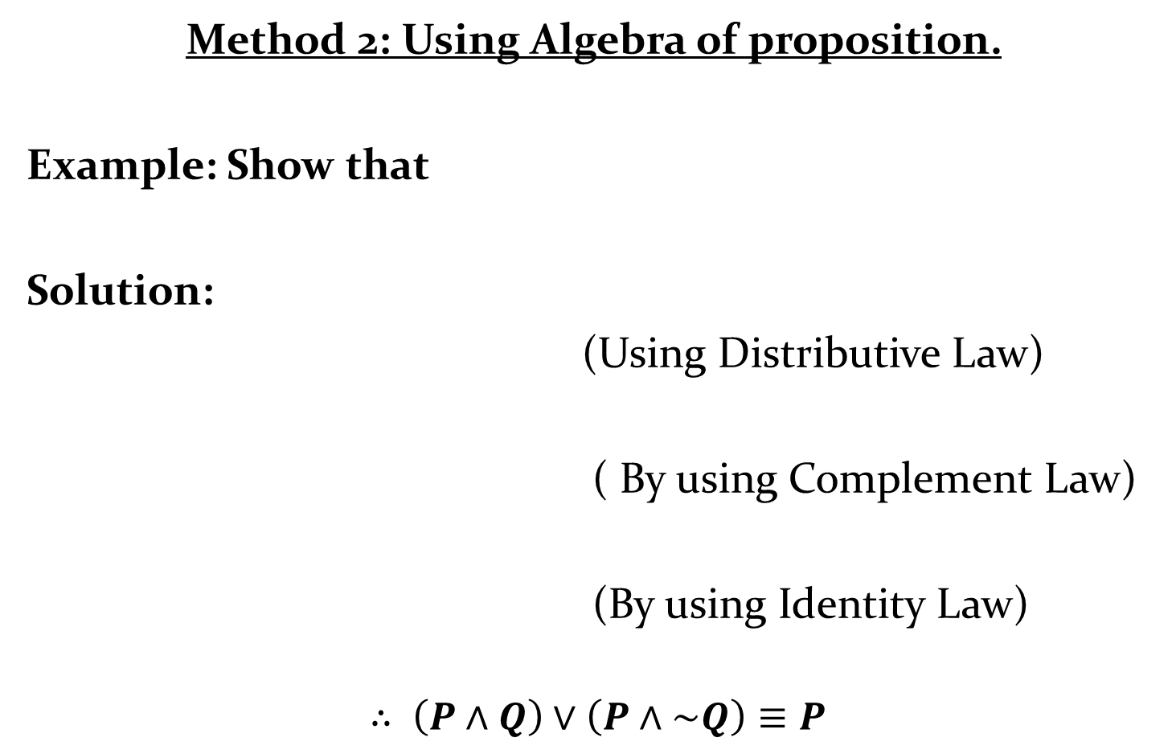


Method 2: Using Algebra of proposition.
Example: Show that
Solution:
(Using Distributive Law)
( By using Complement Law)
(By using Identity Law)
$$∴ \left(P∧Q\right)∨\left(P∧\sim Q\right)≡P$$
$\left(P∧Q\right)∨\left(P∧\sim Q\right)≡P$.
$$\left(P∧Q\right)∨\left(P∧\sim Q\right)≡P∧\left(Q∨\sim Q\right)$$
$$≡P∧T$$
$$≡P$$
$$=R.H.S$$

Slide 31







$$\left(P→Q\right)∧\left(R→Q\right)≡\left(P∨R\right)→Q.$$
Example: Show that
Solution:
( Equivalent form of
(Commutative Law)
( Distributive Law)
(De Morgan's Law)
(Commutative Law)
( Equivalent form of
Hence Proved.
$$\left(P→Q\right)∧\left(R→Q\right)≡\left(\sim P∨Q\right)∧\left(\sim R∨Q\right)$$
$$P→Q≡\sim P∨Q)$$
$$≡\left(Q∨\sim P\right)∧\left(Q∨\sim R\right)$$
$$≡ Q∨\left(\sim P∧\sim R\right)$$
$$≡Q ∨\left(\sim \left(P∨R\right)\right)$$
$$≡\left(\sim \left(P∨R\right)\right)∨Q$$
$$≡\left(P∨R\right)→Q$$
$P→Q≡\sim P∨Q$ )

Slide 32

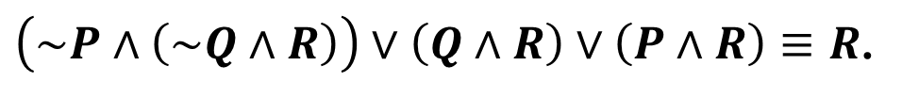






$\left(\sim P∧\left(\sim Q∧R\right)\right)∨\left(Q∧R\right)∨\left(P∧R\right)≡R$.
Example: Show that
Solution: L.H.S:
$≡\left(\left(\sim P∧\sim Q\right)∧R\right)∨\left(Q∧R\right)∨\left(P∧R\right)$
(Associative Law)
( De Morgan Law)
(Distributive Law)
( Commutative Law)
( Complement Law)
( Identity Law)
Hence Proved.
$$\left(\sim P∧\left(\sim Q∧R\right)\right)∨\left(Q∧R\right)∨\left(P∧R\right)$$
$$≡\left(\sim \left(P∨Q\right)∧R\right)∨\left(Q∧R\right)∨\left(P∧R\right)$$
$$≡\left(\sim \left(P∨Q\right)∧R\right)∨\left(\left(Q∨P\right)∧R\right)$$
$$≡\left(\sim \left(P∨Q\right)∧R\right)∨\left(\left(P∨Q\right)∧R\right)$$
$$≡\left(\sim \left(P∨Q\right)∨\left(P∨Q\right)\right)∧\left(R\right)$$
$$≡T∧R$$
$$≡R$$

Slide 33
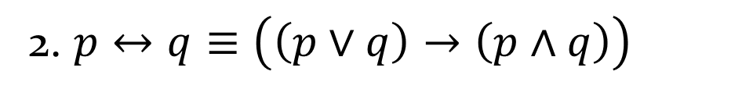


PRATICE EXAMPLE
Example: Show that the following statements are logically equivalent using truth table.
Show that the following statements are logically equivalent without using truth table.
$$1. p↔q≡\left(\left(p→q\right)∧\left(q→p\right)\right)$$
2. $p↔q≡\left(\left(p∨q\right)→\left(p∧q\right)\right)$
$$3. \left(p∨q\right)→r≡\left(\left(p→r\right)∧\left(q→r\right)\right)$$
$$4. p↔q≡\left(p∨q\right)→\left(p∧q\right)$$

Slide 34
TAUTOLOGY
TAUTOLOGY: A statement which is always true is known
as Tautology. It is denoted by t or T. It is also known as logical truth.
There are two methods to check whether the given proposition is a Tautology.
1. Using truth table method.
2. without using truth table.( using Identities or algebra of proposition)

Slide 35
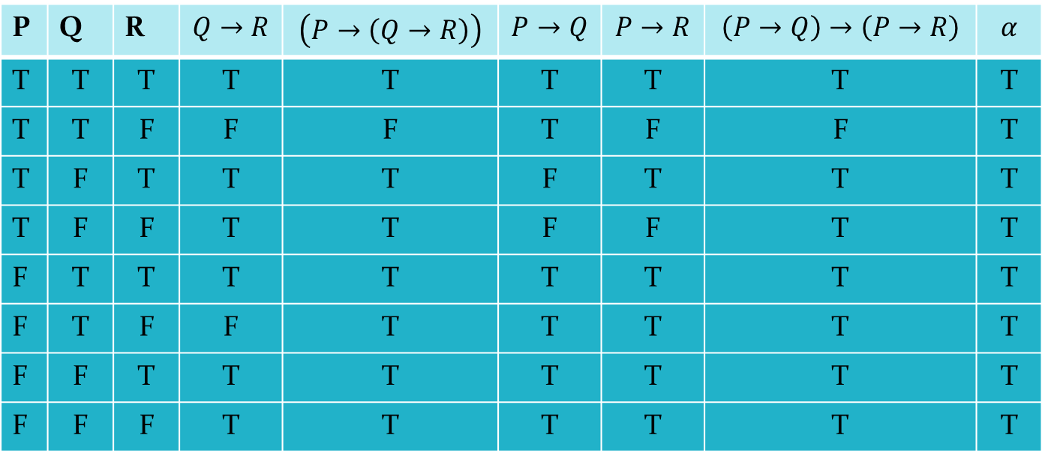
$$\left(P→\left(Q→R\right)\right)→\left(\left(P→Q\right)→\left(P→R\right)\right)$$
Example: Show
is a Tautology.
Solution: Let
Since the truth value is true for all possible values of the propositional variables which can be seen in the last column of the table. Thus, the given proposition is a tautology.
$$α=\left(P→\left(Q→R\right)\right)→\left(\left(P→Q\right)→\left(P→R\right)\right)$$
P | Q | R
T | T | T | T | T | T | T | T | T
T | T | F | F | F | T | F | F | T
T | F | T | T | T | F | T | T | T
T | F | F | T | T | F | F | T | T
F | T | T | T | T | T | T | T | T
F | T | F | F | T | T | T | T | T
F | F | T | T | T | T | T | T | T
F | F | F | T | T | T | T | T | T

Slide 36






Example: Using identities prove that it is a Tautology:
Solution:
(Distributive Law)
(Complement Law)
(Identity Law)
(De Morgan Law)
(Complement Law)
$$Q∨\left(P∧\sim Q\right)∨\left(\sim P∧\sim Q\right)$$
$$Q∨\left(P∧\sim Q\right)∨\left(\sim P∧\sim Q\right)≡\left[\left(Q∨P\right)∧\left(Q∨\sim Q\right)\right]∨\left(\sim P∧\sim Q\right)$$
$$≡\left[\left(Q∨P\right)∧T\right]∨\left(\sim P∧\sim Q\right)$$
$$≡ \left[\left(Q∨P\right)\right]∨\left(\sim P∧\sim Q\right)$$
$$≡ \left[\left(Q∨P\right)\right]∨\sim \left(P∨Q\right)$$
$$≡ \left[\left(Q∨P\right)\right]∨\sim \left(Q∨P\right)$$
$$≡ T$$

Slide 37
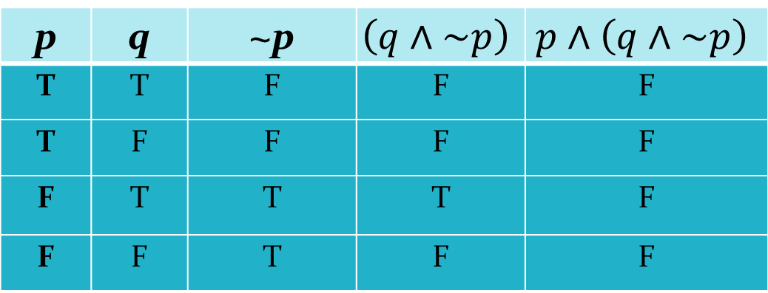
CONTRADICTION: A statement which is always false is known as contradiction or Fallacy. It is denoted by c or F. It is also known as Contradiction or logical false.
Example: Verify that the proposition is a contradiction or not.
Solution:
It is clear from the truth table that for any possible value of p and q , the given proposition is false which establish that given proposition is a contradiction.
p | q | ~p
T | T | F | F | F
T | F | F | F | F
F | T | T | T | F
F | F | T | F | F

Slide 38
PRACTICE EXAMPLE
Example: Show that is a contradiction.
CONTINGENCY: A statement which is neither tautology nor fallacy is known as Contingency.

Slide 39
FUNCTIONALLY COMPLETE SET OF CONNECTIVES:
Any set of connective in which every formula can be expressed in terms of an equivalence formula containing the connectives from the set is called functionally complete set of connectives.
Remark: A minimal functionally complete set of Connectives does not contain a connective which can be expressed in terms of other connectives.

Slide 40
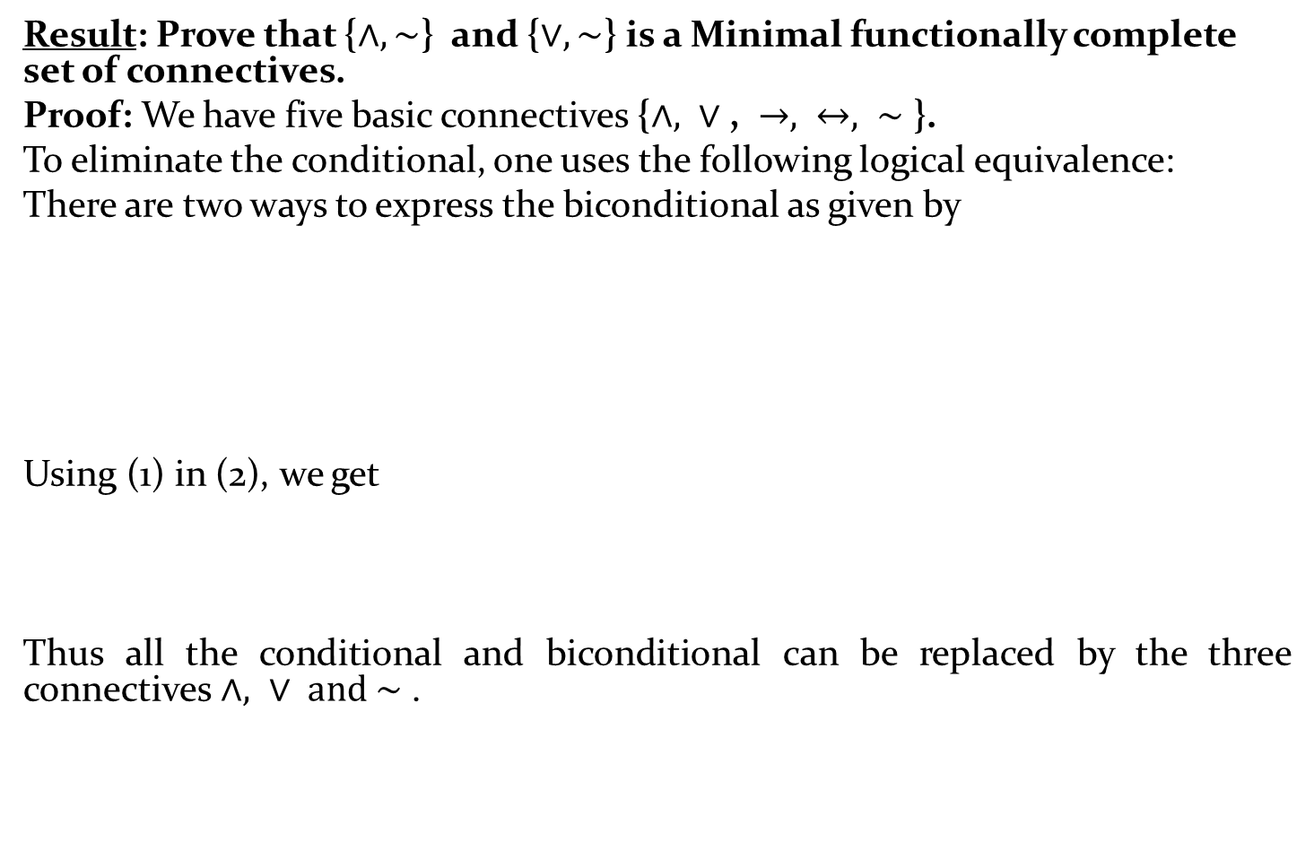
Result: Prove that {$∧, \sim$} and {$∨, \sim$} is a Minimal functionally complete set of connectives.
Proof: We have five basic connectives {$∧, ∨\text{,} →, ↔, \sim$ }.
To eliminate the conditional, one uses the following logical equivalence:
There are two ways to express the biconditional as given by
Using (1) in (2), we get
Thus all the conditional and biconditional can be replaced by the three connectives $∧, ∨ \text{and} \sim$ .

Slide 41
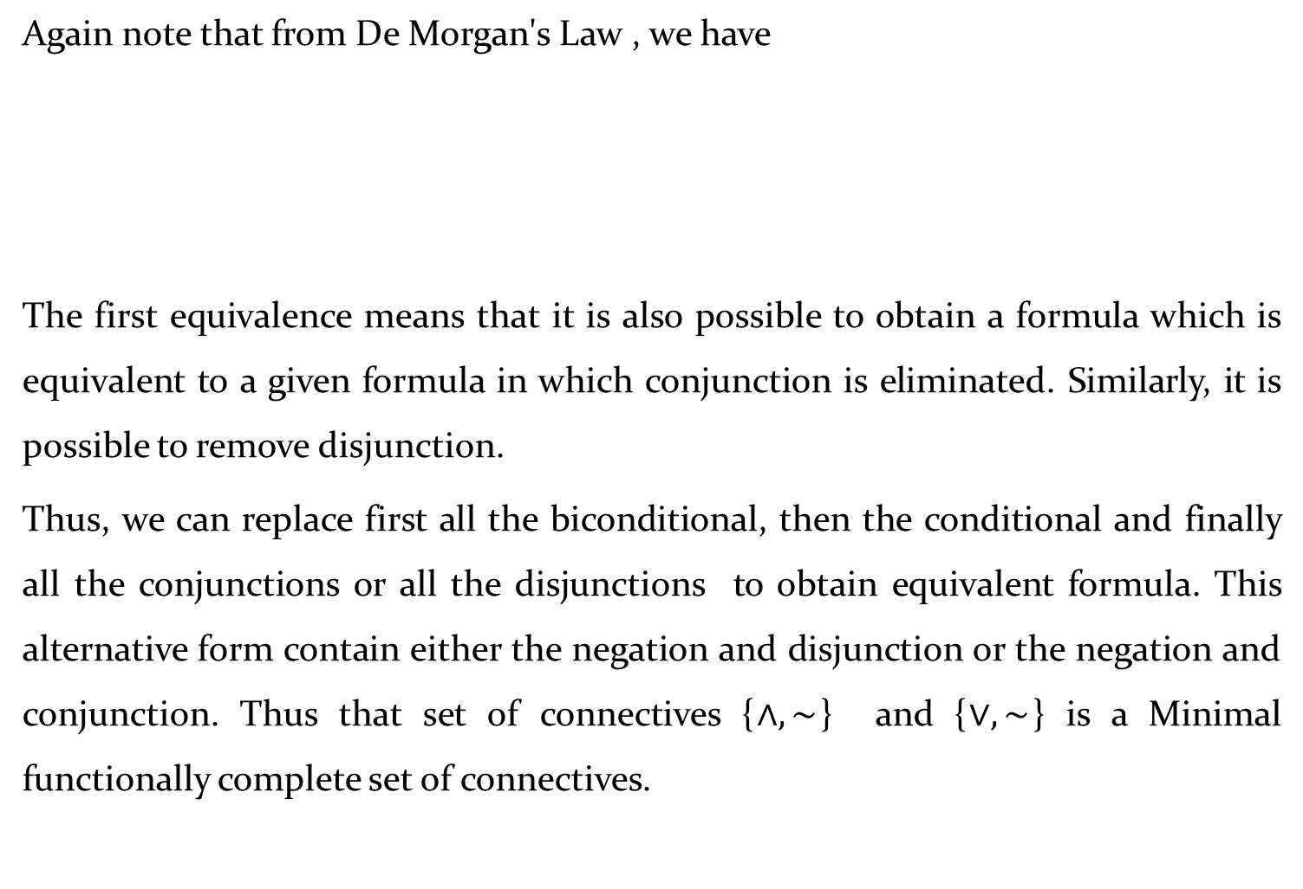
Again note that from De Morgan's Law , we have
The first equivalence means that it is also possible to obtain a formula which is equivalent to a given formula in which conjunction is eliminated. Similarly, it is possible to remove disjunction.
Thus, we can replace first all the biconditional, then the conditional and finally all the conjunctions or all the disjunctions to obtain equivalent formula. This alternative form contain either the negation and disjunction or the negation and conjunction. Thus that set of connectives {$∧, \sim$} and {$∨, \sim$} is a Minimal functionally complete set of connectives.

Slide 42
NORMAL FORM: By comparing truth tables, one determines whether two logical expression P and Q are equivalent. But the process is very tedious when the number of variables increases. A better method is to transform the expression P and Q to some standard forms of expression P’ and Q’ such that a simple comparison of P’ and Q’ shows whether they are equivalent or not.
The standard forms are called normal forms or canonical forms.
ELEMENTARY SUM: In logical expression, a sum of the variables and their negation is called elementary sum. Example of elementary sum :

Slide 43
ELEMENTARY PRODUCT: In logical expression, a product of variables and their negation is called an elementary product. Example: p, ~p, is elementary products in two variables p and q.
Disjunctive Normal Form (DNF): A logical expression is said to be in disjunctive normal form if it is the sum of elementary products.
PROCEDURE TO OBTAIN DNF OF A GIVEN LOGICAL EXPRESSION:
1)Remove Conditional and Biconditional using an equivalent expression which contains negation, disjunction and conjunction only.

Slide 44
2) Eliminate negation before the sum and products using De Morgan’s Law.
3) Apply distributive law until a sum of elementary product is obtained.
EXAMPLE: Obtain the disjunctive normal form of the following:
1)
Solution:
Step 1: Remove by logically equivalent statement
Step 2: Apply distributive law
which is the required disjunctive normal form (DNF).

Slide 45
2)
Solution:

Slide 46
3)
Solution:
which is the required disjunctive normal form.
Remark: Disjunctive normal form (DNF)of logical expression is not unique.

Slide 47
CONJUNCTIVE NORMAL FORM (CNF): A logical expression is said to be in disjunctive normal form if it is the product of elementary sum.
PROCEDURE TO OBTAIN CNF OF A GIVEN LOGICAL EXPRESSION:
1) Remove Conditional and Biconditional using an equivalent expression which contains negation, disjunction and conjunction only.
2) Eliminate negation before the sum and products using De Morgan’s Law.
3) Apply distributive law until a sum of elementary product is obtained.

Slide 48
EXAMPLE: Obtain the conjunctive normal form of the following:
1)
Solution:

Slide 49
2)
Solution:
Which is required CNF.

Slide 50
Remark: Conjunctive normal form (CNF) of logical expression is not unique.
Point to remember for DNF and CNF

Slide 51
PRINCIPAL DISJUNCTIVE NORMAL FORM (PDNF)
MINTERMS: Let p and q be two statement variables then are called minterms of p and q. The number of minterms in n variables is 2^{n}.
For example the minterms for three variables p, q and r are
The truth table for the minterms of p and q are given below:
p | q
T | T | T | F | F | F
T | F | F | F | T | F
F | T | F | T | F | F
F | F | F | F | F | T

Slide 52
REMARKS:
From the truth table it is clear that no minterms are equivalent.
Each minterms has truth value T for exactly one combination of the truth values of the variables p and q.
Principal Disjunctive Norm Form (PDNF): PDNF of a given formula can be defined as an equivalent formula consisting of disjunctives of minterms (elementary product which contains the entire variables) only. This is also known as sum of products canonical form. There are two ways to obtain the principal disjunctive normal form.
Method 1: Using Truth Table.
Method 2: Without Using Truth Table.

Slide 53
Method 1: Using Truth Table.
Step 1: Construct a truth table for the given compound statement.
Step 2: For every truth value T of the given proposition, select the minterms which has also true value T for the same combination of truth value of the statement variable.
Step 3: The disjunctive of minterms selected in step 2 is the required principal disjunctive normal form.
Remark: In PDNF, the repeated minterms are mention only once.

Slide 54
Example: Obtain the principal disjunctive normal form using the truth table of .
Solution: The truth table for is given by
p | q
T | T | T
T | F | F
F | T | T
F | F | T

Slide 55
The column containing has truth value T for three combination of the truth values of p and q.
T in the first row of corresponds to the minterms
, ( refer TABLE: Minterms)
T in the third row of corresponds to the minterms
, ( refer TABLE: Minterms)
T in the fourth row of corresponds to the minterms
, ( refer TABLE: Minterms)
Thus, PDNF of is .

Slide 56
Method 2: Without Using Truth Table.
Step 1: Obtain the disjunctive normal form.
Step 2: Drop elementary products which are contradictions.
Step 3: If p_{i} and ~p_{i} are missing in an elementary product , replace α by .
Step 4: Repeat step 3 until all elementary products are reduced to sum of minterms. Identical minterms appearing in the disjunction are deleted.

Slide 57
POINTS TO BE REMEMBER FOR PDNF WITHOUT USING TRUTH TABLE
After finding DNF, we apply identity law, complement law and Distributive Law.
Identity law for DNF is .
Complement Law is .

Slide 58
Example: Obtain the Principal Disjunctive Normal Form of the following without using the truth table.
1)
Solution: From DNF, We have .
Thus, the required PDNF is

Slide 59
2)
Solution:
( In PDNF each minterms appear once so we mention the repeated minterms only once.)

Slide 60
3)
Solution:
In the given formula is already a minterms so we convert
into minterms. Now,
The required PDNF form using (1) is

Slide 61
4)
Solution:
(Remark: PDNF contain minterms and, minterms include entire variable of compound statement so we introduce the missing terms using identity and complement law in 1st term p , 2nd term q and3rd r)

Slide 62
Now we simplify 1st bracket using distributive law we get

Slide 63
Similarly we can simplify 2nd and 3rd bracket are given by
Therefore required PDNF is

Slide 64
5)
Solution:
Which is required PDNF.

Slide 65
6)
Solution:
is in DNF.
Now we convert it into PDNF form as follows:
In order to find the PDNF we first find the minterms for 1st term (since minterms contain entire variable so we introduce the missing variable r in the 1st term using identity, complement and distributive law)

Slide 66
Similarly and can be converted into following minterms
Therefore PDNF form of is

Slide 67
Advantages of obtaining principal disjunctive normal form are as below.
The principal disjunctive normal of a given formula is unique.
Two formulas are equivalent if and only if their principal disjunctive normal forms coincide.
If the given compound proposition is a tautology, then its principal disjunctive normal form will contain all possible minterms of its components.

Slide 68
PRINCIPAL CONJUNCTIVE NORMAL FORM
MAXTERMS: Let p and q be two statement variables then
are called maxterms of p and q. The number of maxterms in n variables is 2^{n}.
For example the maxterms for three variables p, q and r are
The truth table for the minterms of p and q are given below:
Table: Maxterms
p | q
T | T | T | T | T | F
T | F | T | F | T | T
F | T | T | T | F | T
F | F | F | T | T | T

Slide 69
REMARKS:
From the truth table it is clear that no max terms are equivalent.
Each max term has truth value F for exactly one combination of the truth values of the variables p and q.
PRINCIPAL CONJUNCTIVE NORMAL FORM:
It is defined as an equivalent formula consists of conjunctive of max terms only. It is also called the product of sums canonical form. There are two ways to obtain the principal disjunctive normal form.
Method 1: Using Truth Table.
Method 2: Without Using Truth Table.

Slide 70
Method 1: Using Truth Table
Step 1: Construct a truth table for the given compound statement.
Step 2: For every truth value F of the given proposition, select the maxterms which has also true value F for the same combination of truth value of the statement variable.
Step 3: The conjunctive of maxterms selected in step 2 is the required principal conjunctive normal form.

Slide 71
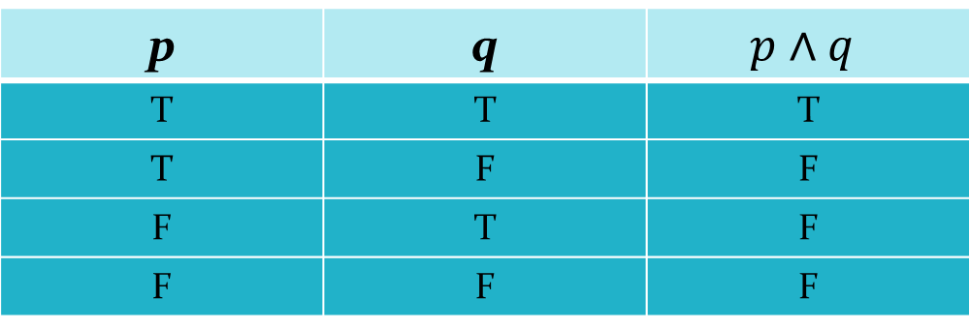

Remark: In PCNF, the repeated maxterms are mention only once.
Example: Obtain the Principal Conjunctive Normal Form of
1) $p∧q.$
The column containing $p∧q$ truth value F for the three combination of the truth value of p and q. Now use following using truth table.
p | q
T | T | T
T | F | F
F | T | F
F | F | F

Slide 72
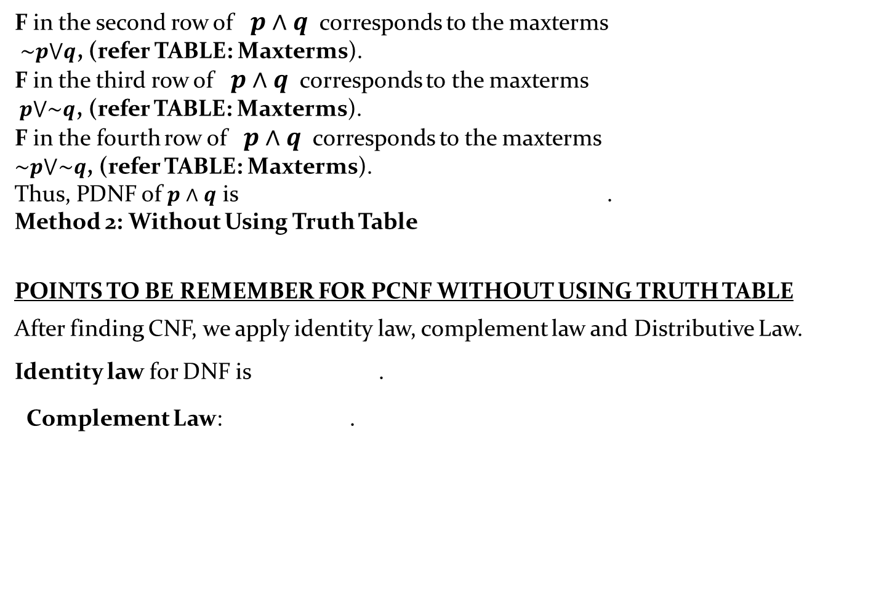
F in the second row of $p∧q$ corresponds to the maxterms
$\sim p⋁q$, (refer TABLE: Maxterms).
F in the third row of $p∧q$ corresponds to the maxterms
$p⋁\sim q$, (refer TABLE: Maxterms).
F in the fourth row of $p∧q$ corresponds to the maxterms
$\sim p⋁\sim q$, (refer TABLE: Maxterms).
Thus, PDNF of $p∧q$ is .
Method 2: Without Using Truth Table
POINTS TO BE REMEMBER FOR PCNF WITHOUT USING TRUTH TABLE
After finding CNF, we apply identity law, complement law and Distributive Law.
Identity law for DNF is .
Complement Law: .

Slide 73

Example: Obtain the Principal Conjunctive Normal Form of the following without using truth table.
1) $p∧q.$
Solution: $p∧q$ is the CNF form.
[Remark: Since p and q are individual variable so we introduce the missing variable q in the 1st term p and missing variable p in the 2nd term q to obtain the maxterms.]

Slide 74
The required PCNF form is
2)
Solution: First we find CNF form using logical equivalent statement of
[Remark: From CNF we find PCNF by introducing the missing variable q, r and r in 1st , 2nd , 3rd term respectively using identity , complement to obtain the maxterms and apply distributive law to find the PCNF ]

Slide 75
Now,
Thus,
Similarly, we have
Putting the value from (A), (B), (C) in (1) we get PCNF as

Slide 76
Advantages of obtaining principal conjunctive normal form are
The principal conjunctive normal of a given formula is unique.
Every compound proposition, which is not a tautology, has an equivalent principal conjunctive normal form.
If the given compound proposition is a contradiction, then its principal conjunctive normal form will contain all possible maxterms of its components.

Slide 77
PRATICE EXAMPLE
Obtain the PDNF and PCNF form of the following without using truth table.

Slide 78
LOGIC IN PROOF
Theorem: A theorem is a proposition that can be proved to be true.
Premises: It is a proposition on the basis of which we would able to draw a conclusion. You can think of premise as evidence or assumption.
Therefore we initially assume that something is true and on the basis of that we draw the conclusion.
Conclusion: It is a proposition that is reached from the given set of premises. You can of it as the result of the assumptions that we made in an argument.

Slide 79
Argument: An argument is a sequence of statement that ends with the conclusion. All statements except last one are known as premises or hypothesis .And the last statement is known as conclusion.
Proof: An argument which establishes the truth of the theorem is known as proof.
Valid Argument: An argument is said to be valid, if all premises are true, conclusion must be true in the same possibility. Validity of the argument can be check using two methods

Slide 80
Truth Table Technique
Without using Truth Table Technique / using rule of inference.
Method 1: Truth Table Technique
Step 1: Construct a truth table for Premises and the Conclusion.
Step2: Find the rows in which all the premises are true .This rows are called as critical rows
Step 3: Check conclusion of all critical rows.
A) If in each critical row conclusion is true then the argument is valid.
B) If there is a row in which conclusion is false then the argument form is invalid.

Slide 81
Example: Determine whether the following argument form is valid or invalid
Solution:
p | q | r | ~r
T | T | T | F | T | T | T | T | T
T | T | F | T | T | F | T | F | F
T | F | T | F | F | T | F | T | T
T | F | F | T | T | F | T | T | F
F | T | T | F | T | F | T | F | T
F | T | F | T | T | F | T | F | T
F | F | T | F | F | F | T | T | T
F | F | F | T | T | F | T | T | T

Slide 82
PRATICE EXAMPLE
Example: Determine whether the conclusion C follows logically from the premises H₁ and H₂ using truth table technique.

Slide 83
Theoretically, it is possible to determine in a finite number of steps whether a conclusion follows from a given set of premises by constructing the appropriate truth table. However, this method become tedious when the number of atomic variables present in all the formulas representing the premises and conclusion is large. This disadvantage, coupled with the fact that the inference theory is applicable in more general situations where the truth table technique is tedious task.

Slide 84
RULES OF INFERENCE
The rules of inference are criteria for determining the validity of an argument. Any conclusion which is arrived by following rules of inference is called a valid conclusion, and the argument is called a valid argument.

Slide 85
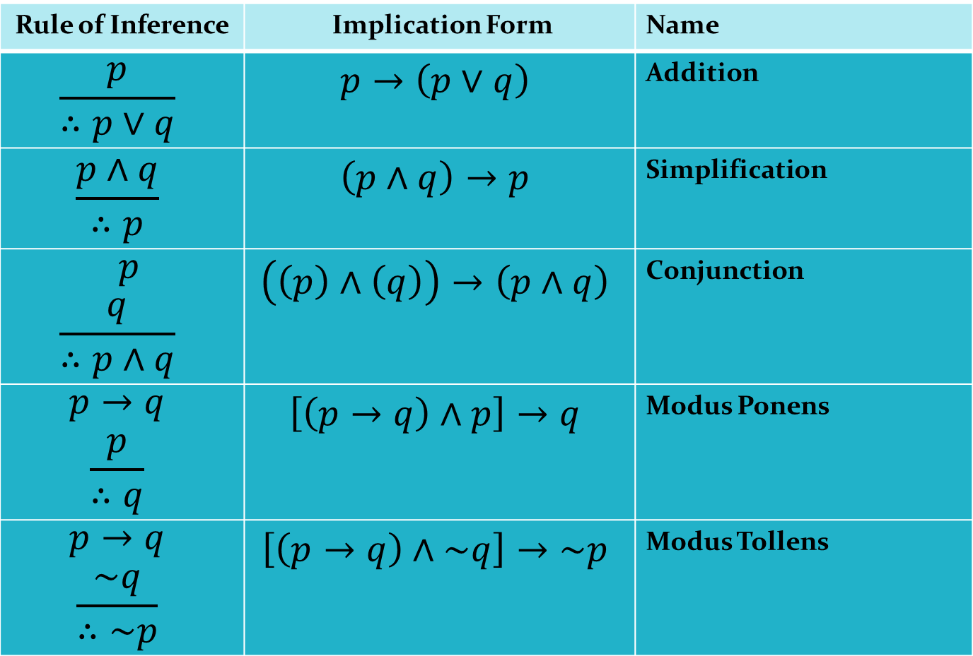
Rule of Inference
Rule of Inference | Implication Form | Name
 |  | Addition
 |  | Simplification
 |  | Conjunction
 |  | Modus Ponens
 |  | Modus Tollens

Slide 86
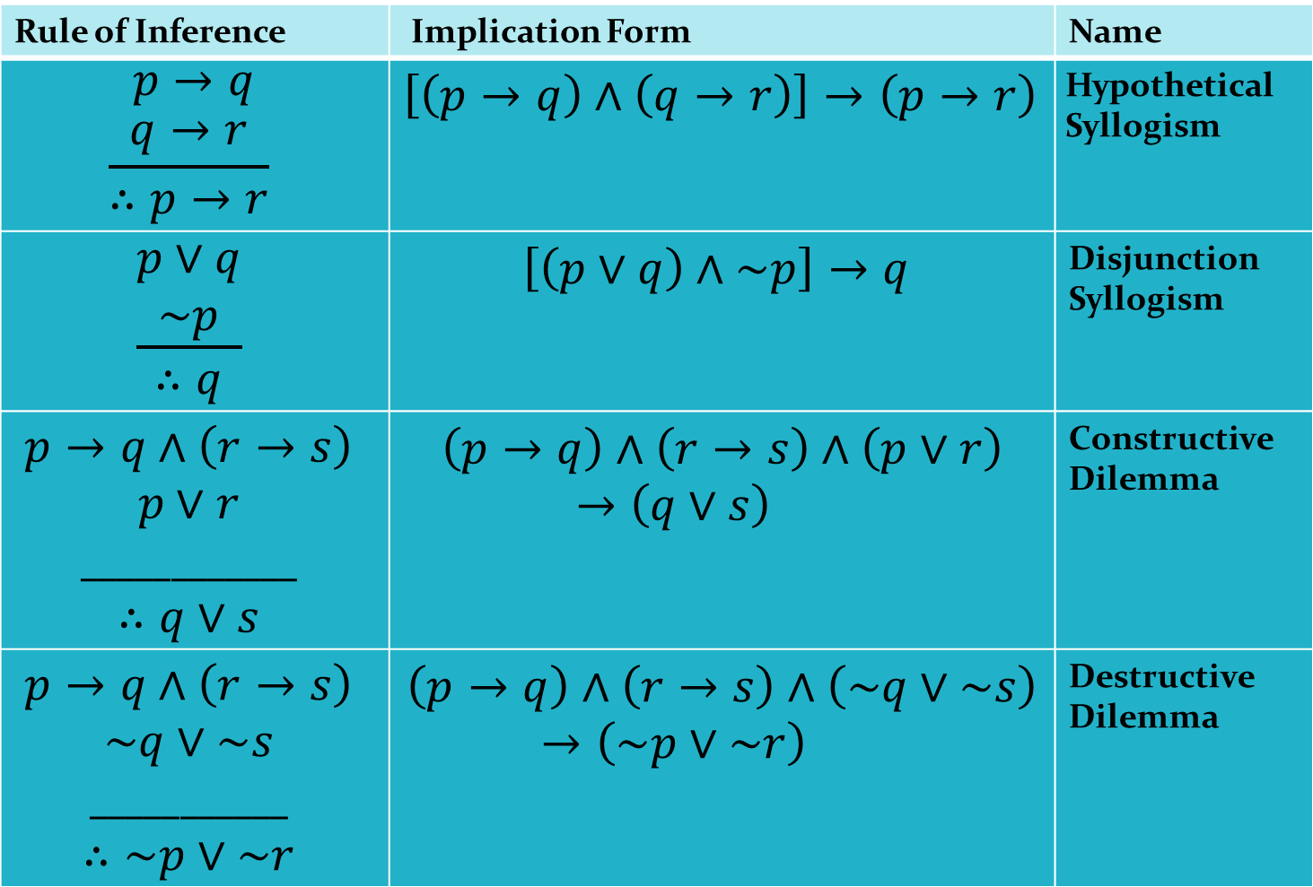
Table: Rule of Inference (Continued)
Rule of Inference | Implication Form | Name
 |  | Hypothetical Syllogism
 |  | Disjunction Syllogism
 |  | Constructive Dilemma
 |  | Destructive Dilemma

Slide 87




Example: Can we conclude S from the following premises?
(i)
(ii)
(iii)
(iv)
Solution: The valid argument for deducing S from the given four premises is given as sequence. On left formula is given. On the right, we indicate whether the proposition is premise or a conclusion. If it is conclusion, we indicate the premises and the rules of inference or logical identities used for deriving the conclusion.
$$P→Q$$
$$P→R$$
$$\sim \left(Q∧R\right)$$
$$S∨P$$

Slide 88
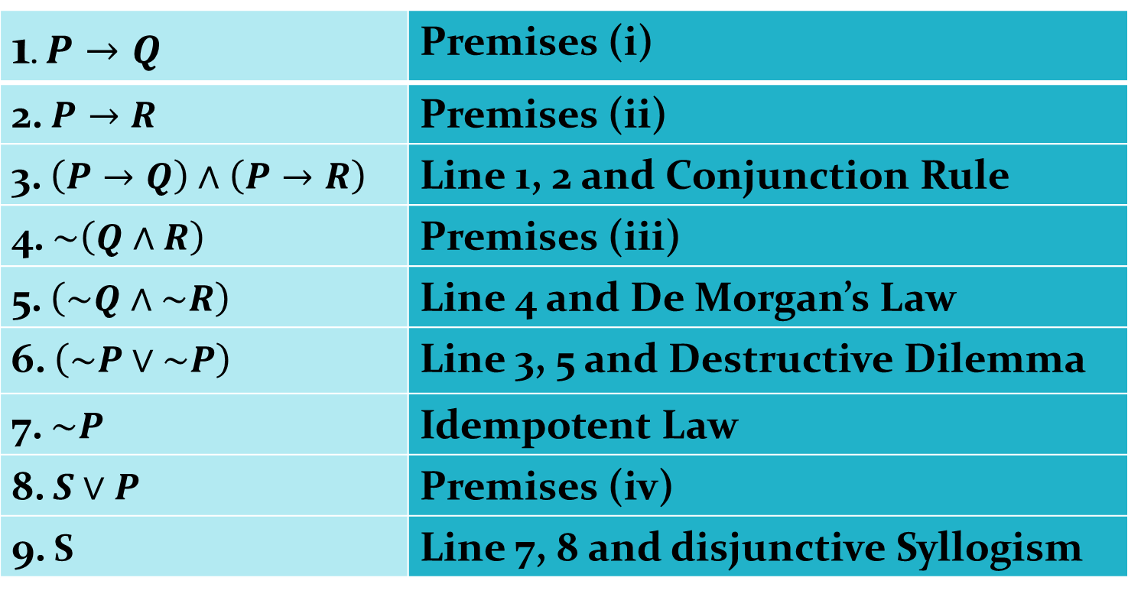
Solution:
Thus, S is the conclusion from the given premises.
 | Premises (i)
 | Premises (ii)
 | Line 1, 2 and Conjunction Rule
 | Premises (iii)
 | Line 4 and De Morgan’s Law
 | Line 3, 5 and Destructive Dilemma
 | Idempotent Law
 | Premises (iv)
9. S | Line 7, 8 and disjunctive Syllogism

Slide 89


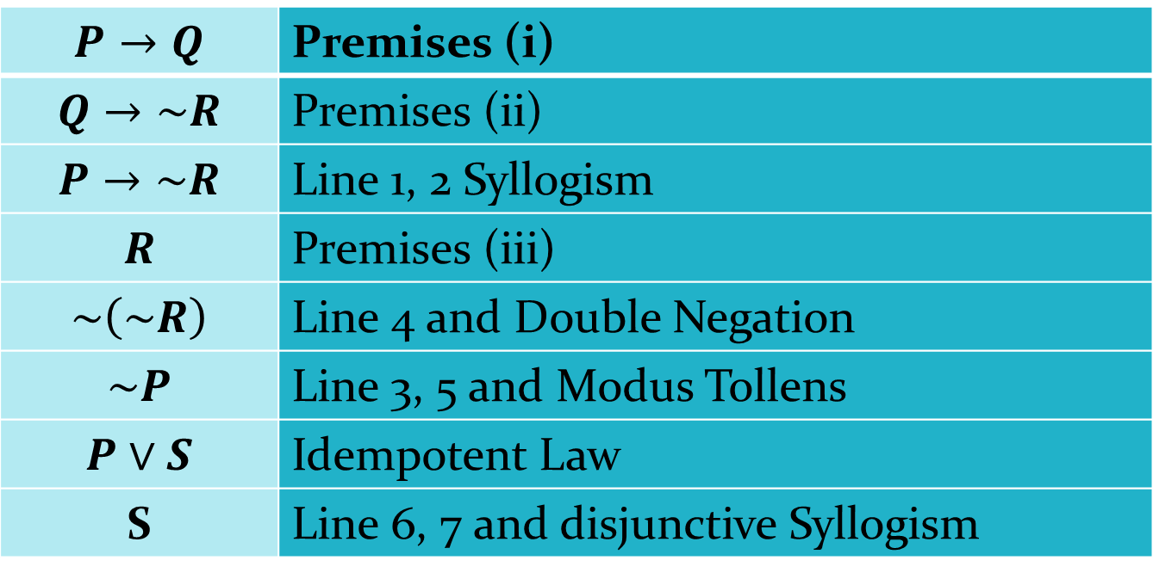

Example: Derive S from the following premises using a valid argument? (i) (ii) (iii) (iv) R
Solution:
Thus, S is the conclusion from the given premises.
$$P→Q$$
$$Q→\sim R$$
$\left(P∨S\right)$
 | Premises (i)
 | Premises (ii)
 | Line 1, 2 Syllogism
 | Premises (iii)
 | Line 4 and Double Negation
 | Line 3, 5 and Modus Tollens
 | Idempotent Law
S | Line 6, 7 and disjunctive Syllogism

Slide 90



Example: Check the validity of the following argument:
If Ram has completed B.E. or MBA, then he is assured of a good job. If Ram is assured of a good job, he is happy. Ram is not happy. So Ram has not completed MBA.
Solution: Let p: Ram has completed B.E.
q: Ram has completed MBA.
r: Ram is assured of a good job.
s: Ram is happy.
The given premises are
(i)
(ii)
(iii)
The conclusion is ~q
$$\left(p∨q\right)→r$$
$$r→s$$
$$\sim s$$

Slide 91
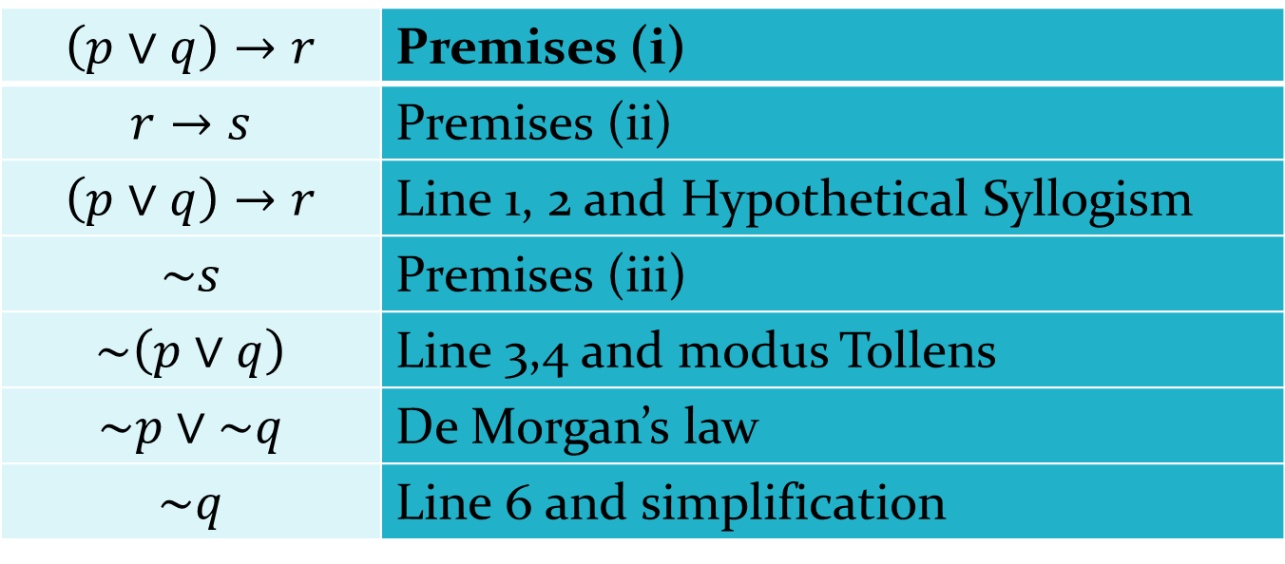
Therefore the argument is valid .
 | Premises (i)
 | Premises (ii)
 | Line 1, 2 and Hypothetical Syllogism
 | Premises (iii)
 | Line 3,4 and modus Tollens
 | De Morgan’s law
 | Line 6 and simplification

Slide 92



Example: Check the validity of the following arguments: If milk is black then every cow is white .If every cow is white then it has four legs. If every cow has four legs then every buffalo is white and brisk. The milk is black.
Therefore, the buffalo is white.
Solution: P: The milk is black.
Q: Every cow is white.
R: Every cow has four legs.
S: Every buffalo is white.
T: Every buffalo is brisk .
The given premises are
(i) (ii)
(iii) (iv) P
The conclusion is S.
$$P→Q$$
$$Q→R$$
$$R→S∧T$$

Slide 93
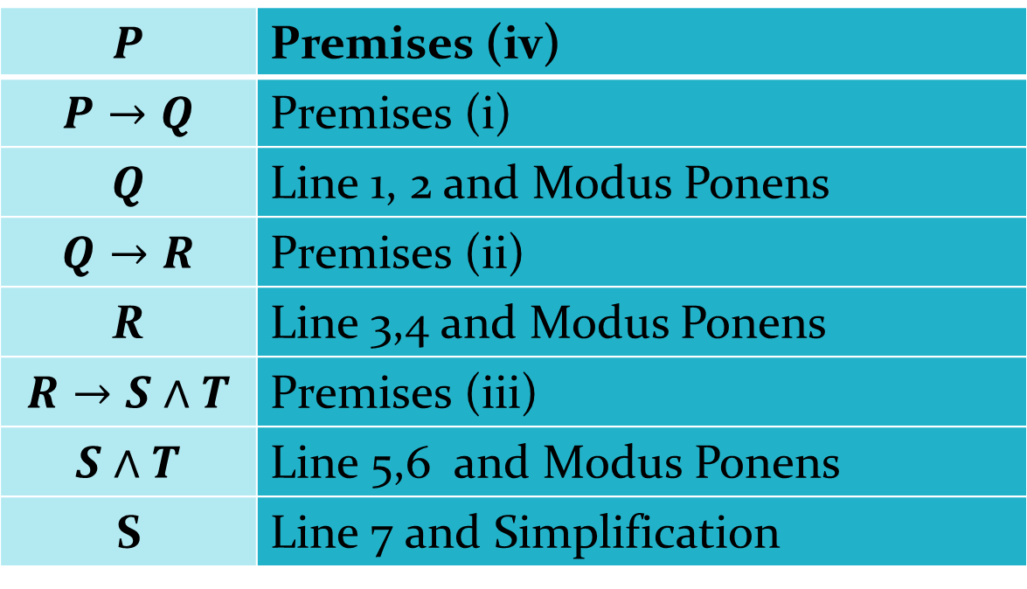
Therefore the argument is valid
 | Premises (iv)
 | Premises (i)
 | Line 1, 2 and Modus Ponens
 | Premises (ii)
R | Line 3,4 and Modus Ponens
 | Premises (iii)
 | Line 5,6 and Modus Ponens
S | Line 7 and Simplification

Slide 94
PREDICATE CALCULUS
IMPORTANCE OF PREDICATE CALCULUS:
The propositional calculus does not allow us to represent many of the statements that we use in mathematics, computer science and in everyday life. Predicate calculus is a generalization of propositional calculus .It contains all the components of the propositional calculus, including propositional variables and constants. Predicate calculus is important for several reasons; this has application in expert system, in database and also basis for the Prolong language.

Slide 95
PREDICATES:A part of a declarative sentence describing the properties of an object or relation among objects is called a predicate .For example ‘is a student ‘ is a predicate.
Sentence involving predicates describing the property of objects are denoted by P(x), where P denotes the predicate and x is a variable denoting any object. For example, P(x) can denote ‘ x is student’. In this sentence, x is a variable and P denotes the predicate ‘ is student ‘.
UNIVERSE OF DISCOURSE OR DOMAIN OF COURSE: For a declarative sentence involving a predicate, the universe of discourse, or simply the universe, is the set of all possible values which can be assigned to variables. For example ,the universe of discourse for P(x): “x is a student” can be taken as the set of all human names.

Slide 96
UNIVERSAL AND EXISTENTIAL QUANTIFIERS
Universal Quantifiers: The phrase ‘ for all ‘ ( denoted by ) is called the universal quantifier. Using this symbol we can write “ For all x, x²=(-x)²” as where Q(x) is ‘x²=(-x)² .The symbol can be read as ‘ for every’ , ‘ for any’ , ‘for each’, ‘ for arbitrary’.
EXISTENTIAL QUANTIFIERS: The phrase ‘there exists’ (denoted by ) is called the existential quantifiers. The sentence ‘There exist x such that x²=5’ can be written as x, R(x), where R(x) is x²=5’ .

Slide 97
Note: when we use quantifiers, we should specify the universe of discourse. If we change the universe of discourse, the truth value may change. For example, consider x, R(x), where R(x) is x²=5’.If the universe of discourse is the set of all integers, and then x, R(x) is false. If the universe of discourse is the set of all real.
EXAMPLE: Express the following sentences involving predicates in symbolic form:
numbers, then x, R(x) is true
1. All students are clever.
2. Some students are not successful.
3. Every clever student is successful.
4. There are some successful students who are not clever.
5. Some students are clever and successful.

Slide 98
SOLUTION: As quantifiers are involved, we have to specify the universe of discourse. The universe of discourse as the set of all students.
Let C(x) denote ‘x is clever’.
Let S(x) denote “ x is successful’.
All students are clever | x, C(x)
Some students are not successful. | x, S(x)
Every Clever student is successful
There are some successful students who are not clever
Some students are clever and successful

Slide 99
PREDICATE FORMULA IS VALID: A predicate formula is valid if for all possible assignments of value from the universe of discourse to free variables, the resulting propositions have the truth value T.
PREDICATE FORMULA IS STAISFIABLE: A predicate formula is satisfiable if for some assignment of values to predicate variables the resulting proposition has the truth value T.
PREDICATE FORMULA IS UNSATISFIABLE: A predicate formula is unsatisfiable if for all possible assignments of values from any universe of discourse to predicate variables the resulting propositions have the truth value F.

Slide 100
RULE OF INFERENCE FOR PREDICATE CALCULUS
Rule of Inference | Name
c is some element of the universe. | Universal Instantiation
 | Existential Instantiation
x should not be free in any of the given premises. | Universal Generalization
c is some element of the universe. | Existential Generalization

Slide 101
EXAMPLE: Discuss the validity of the following argument
All graduates are educated.
Ram is a graduate.
Therefore , Ram is educated.
Solution: Let G(x) denote ‘ x is a graduate’.
Let E(x) denote ‘ x is educated’
Let R denote ‘ Ram’ .
PREMISES are
1)
2)G(R)
CONCLUSION E(R)

Slide 102
Thus the conclusion is valid.
1. | Premise (i)
2. | Universal Instantiation
3. G(R) | Premise (ii)
 | Modus Ponens

Slide 103
EXAMPLE 2: Discuss the validity of the following argument:
All graduates can read and write,
Ram can read and write.
Therefore, Ram is graduate.
Solution: Let G(x) denote ‘ x is a graduate’.
Let L(x) denote ‘ x can read and write’
Let R denote ‘ Ram’ .
PREMISES are
1)
2) L(R)
CONCLUSION G(R)

Slide 104
is not a tautology. So we cannot derive G(R).For example, a school boy can read and write and he is not a graduate.
So the conclusion is not valid.
1. | Premise (i)
2. | Universal Instantiation
3. L(R) | Premises (ii)

